Slide 1

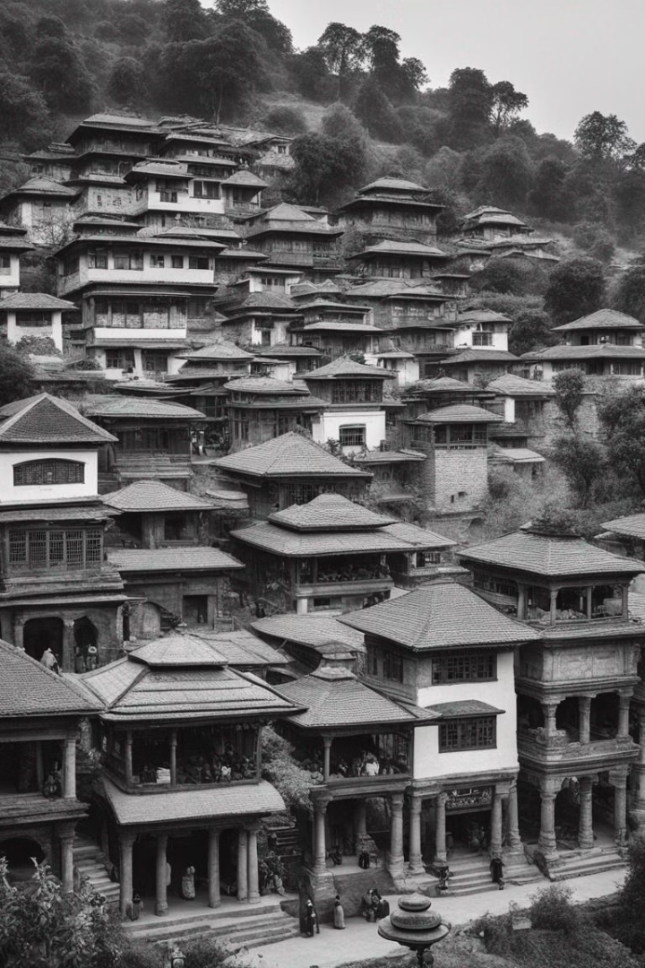


History of Dhulikhel
The name Dhulikhel originates from the Nepal Bhasha word Dhali_khela, which evolved from the earlier form Nepal Bhasha name Dhau_khyo. Dhali or Dhau means yogurt, and Khela or Khyo means a field in Nepala Bhasha. It is believed to have come from the Lichchhi name Dhawalasrotapura. Initially, Dhulikhel served as the eastern border of the ancient Nepal Mandala and was among the territories of the Bhaktapur kingdom.
by Atul Dhital

Slide 2
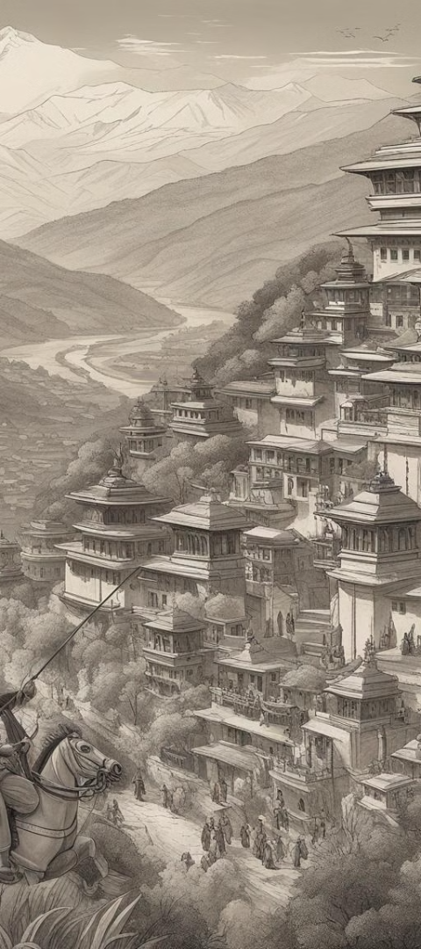



Formation of Dhulikhel
Resistance by Locals
The brave locals resisted the Gorkha kingdom expansion, with Prithvi Narayan Shah facing significant difficulties in capturing Dhulikhel.
Battle and Victory
After six months of intense fighting, Prithvi Narayan Shah successfully conquered Dhulikhel, leading to its annexation to the Gorkha kingdom.
Administrative Center Shift
Following its conquest, Dhulikhel became the administrative center of Kavrepalanchok, a position it retains till date.

Slide 3

Cultural Significance
1
Traditional Festivals
2
Local Crafts
Dhulikhel is renowned for its vibrant traditional festivals and celebrations, showcasing the rich cultural heritage of the region.
The town is known for its exquisite handcrafted goods, representing the skilled craftsmanship and artistic traditions of the local community.
3
Cultural Diversity
The diverse cultural influences in Dhulikhel contribute to a melting pot of traditions, beliefs, and practices.

Slide 4
Geographic Surroundings
Rural Landscape
Scenic Beauty
Environmental Diversity
The picturesque surroundings of Dhulikhel are characterized by rolling hills, lush forests, and vibrant agricultural fields, creating a serene and captivating environment.
The town's geography offers stunning panoramic views, attracting nature enthusiasts, hikers, and photographers from around the world.
The region's diverse landscape provides a habitat for a variety of flora and fauna, contributing to its ecological significance.

Slide 5
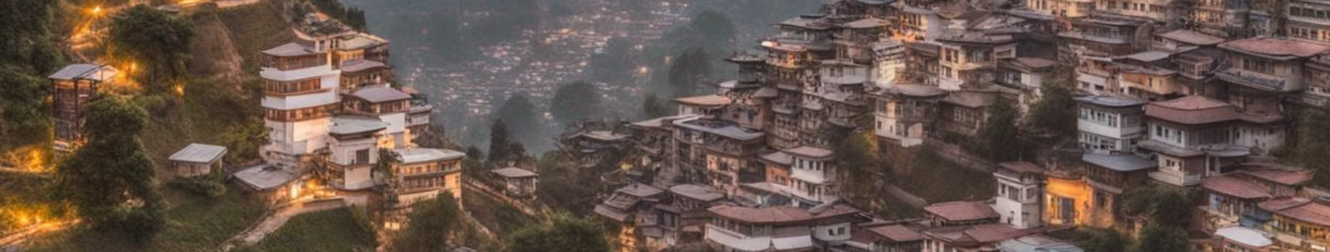
Modern Development
Urban Expansion
Cultural Revival
Educational Hub
Dhulikhel has witnessed rapid urban development, marked by the emergence of modern infrastructure and a bustling commercial center.
While embracing modernity, the town has successfully preserved its cultural heritage, inspiring a harmonious blend of tradition and progress.
It has become a prominent educational hub, offering a range of learning institutions and fostering intellectual growth and innovation in the region.

Slide 6
Tourism and Hospitality
1500+
50%
Stunning Mountain Views
Guesthouses and Hotels
Increase in Tourism
Scenic Attractions

Slide 7


Economic Opportunities
Local Commerce
Employment
The town boasts vibrant marketplaces, serving as a hub for local businesses and entrepreneurial activities.
Dhulikhel provides ample employment opportunities, particularly in traditional craftsmanship, tourism, and modern industries.

Slide 8
Environmental Conservation
Scenic Trails
Opportunities for eco-tourism and outdoor recreation
Wildlife Conservation
Commitment to preserving the region's rich biodiversity and natural habitats
Green Initiatives
Efforts towards sustainable development and environmental protection

